Slide 1

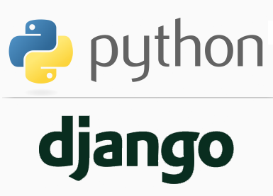
FULL STACK WEB DEVELOPMENT WITH DJANGO
Lecture8

Slide 2

Today’s Agenda
Developing Our Django App
Drawbacks In Configuring Site’s urls.py
Creating App Level urls.py
Configuring The URL
Running The App

Slide 3
Drawbacks In Site Level urls.py
Although configuring our urls in site level urls.py is good for site-wide navigation, but is rarely a good place to put URLs relating to individual applications.

Slide 4
Drawbacks In Site Level urls.py
This is for 3 reasons:
Having all our URLs in the one file is more complex and less portable.
We need to resolve name conflicts while configuring multiple views
Our app becomes dependent on the project so it becomes difficult to use the same app in a different project
To solve this problem, we should set URL patterns at the app level.

Slide 5
Understanding include() Function
To set URL patterns at the app level we have to call a function called as include()
Its general syntax is :
include(app_name.module_name)
Here app_name.module_name is a string representing the name of python module to be included.

Slide 6
Understanding include() Function
This function adds urls from our app directory's urls.py to the main urls.py (in memory).
This keeps the main urls.py from getting too big to read.
For example : path('sales/', include('sales.urls'))
The above code tells Django that if after the base url we have sales/ then the further request processing should be done by urls.py of sales app
The include() will then chop off the URL that matched up to that point and send the remaining URL to the included file.

Slide 7
How To Do App Level URL Patterns ?
To use app level URL pattern we need to take 2 steps:
Create a new urls.py at the app level and add the mapping for the view to be called
Set mapping for the app level’s urls.py inside the site level’s urls.py using the function include().

Slide 8
Initial Steps
Open the main folder i.e. root folder called myvsdjangoproject in VS Code
Activate the virtual environment through command pallette
Open the terminal
Create a new django project by executing the command
django-admin startproject demoproject4

Slide 9
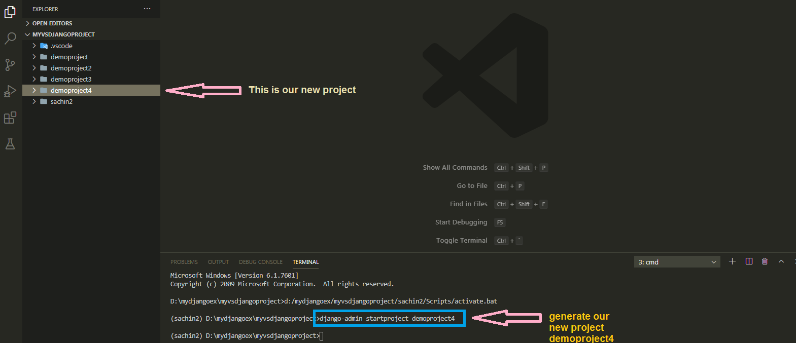
Initial Steps

Slide 10
Initial Steps
Now , in the demoproject4 we will create an app called datetimeapp.
The datetimeapp will have two views , one for showing date and another for showing time

Slide 11
Steps Required
As usual we will follow the same steps as we did before for creating and configuring our new datetimeapp but step 4 ,5 and 6 are new and different
Creating the app
Activating the app
Creating the View
Create a new urls.py in datetimeapp
Configuring the view in datetimeapp’s urls.py
Configure the datetimeapp’s urls.py in site level’s urls.py
Running the server
Opening the page in browser
These 3 are
new steps

Slide 12
Step 1:Creating The datetime App
To create datetimeapp we will go to the outer demoproject4 folder and run the following command:
django-admin startapp datetimeapp
When we execute the above command Django will create appropriate file/folder structure for our app

Slide 13
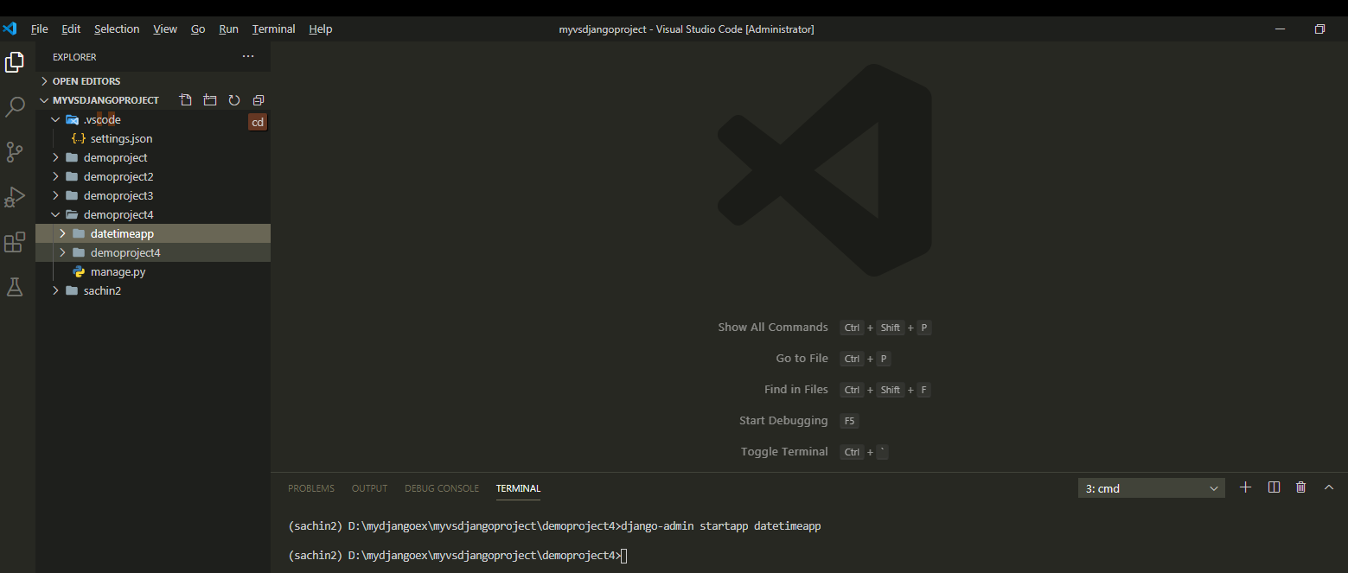
Step 1:Creating The datetime App

Slide 14
Step 2: Activating The App
Just like previous apps , the next step is to add an entry for the datetimeapp in the settings.py of the default demoproject4 app.
For this , open the settings.py file in the inner demoproject4 folder and make the entry shown in green color in the INSTALLED_APPS list
Code:
INSTALLED_APPS = [
'django.contrib.admin',
'django.contrib.auth',
'django.contrib.contenttypes',
'django.contrib.sessions',
'django.contrib.messages',
'django.contrib.staticfiles',
‘datetimeapp',
]

Slide 15
Step 3:Creating The View For datetimeapp
Since the datetimeapp needs to display, date and time , in different views so we will have to create 2 functions called showdate() and showtime() in views.py file of the datetimeapp
Open the views.py file of datetimeapp and write the code shown in the next slide

Slide 16
Step 3:Creating The View For datetimeapp
from django.shortcuts import render
from datetime import datetime
from django.http import HttpResponse
def showDate(request):
currDateTime = datetime.now()
currDate = currDateTime.strftime("%d-%b-%Y")
text= f'<h2>Current date is {currDate}'
return HttpResponse(text)
def showTime(request):
currDateTime = datetime.now()
currTime = currDateTime.strftime("%I:%M:%S %p")
text = f'<h2>Current time is {currTime}'
return HttpResponse(text)

Slide 17
Step 4 & 5 : Creating & Configuring App Level urls.py
In the VS Code create a new file called urls.py in the datetimeapp folder and write the following code in it.
Code (datetime/urls.py):
from django.urls import path
from . import views
urlpatterns = [
path('showdate/', views.showDate),
path('showtime/', views.showTime),
]

Slide 18
Code Explained
urlpatterns = [
path('showdate/', views.showDate),
path('showtime/', views.showTime),
]
As discussed earlier , when we use function include() in main site’s urls.py then Django chops off the URL that matched up to that point and sends the remaining URL to the included file.
So in our case the entire url will be http://127.0.0.1:8000/sca/showdate or http://127.0.0.1:8000/sca/showtime

Slide 19
Code Explained
After chopping off sca/ from the url , Django will forward the remaining url to our urls.py which would be either showdate or showtime
Finally if it is showdate then we have set the mapping for it to the function views.showDate() and if the url is showtime , then have set the mapping for it function views.showTime()

Slide 20
Step 6: Configuring The Sites Main urls.py File
Whenever a request arrives it first hits the main urls.py file , that is , the file urls.py in the app demoproject4.
So , we must configure this file also so that it simply redirects the request to our datetimeapp’s urls.py file whenever a request beginning with sca/ arrives

Slide 21
Step 6:Configuring The Sites Main urls.py File
In the VS Code open the file called urls.py in the demoproject4 folder and update the code in it as shown below in green.
Code (demoproject4/urls.py):
from django.contrib import admin
from django.urls import path,include
urlpatterns = [
path('admin/', admin.site.urls),
path(‘sca/',include(‘daetimeapp.urls')),
]

Slide 22
Code Explained
from django.urls import path,include
This line imports a new function called include()
This function takes the name of a Python module which needs to be included here

Slide 23
Code Explained
urlpatterns = [
path('admin/', admin.site.urls),
path(‘sca/',include(‘dateimeapp.urls')),
]
We have added a new URL dispatcher which is path(‘sca/',include(‘datetimeapp.urls'))
This dispatcher tells Django to simply do 2 things:
Chop off the url till sca/
Send the remaining string to the included URLconf for further processing. which in our case is the module urls.py of greetingsapp

Slide 24
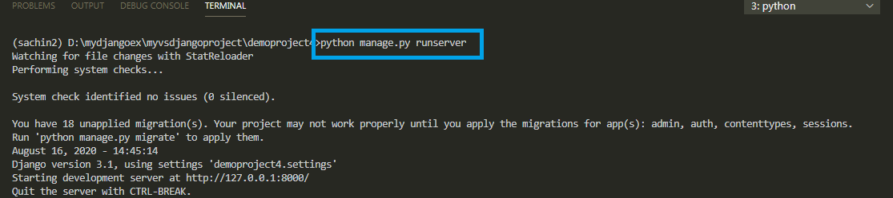
Step 7: Running The Server
To run our new datetimeapp , go to the folder demoproject4 by using cd command and type the runserver command in VS Code terminal
cd demoproject4
python manage.py runserver.
The server runs on the default port 8000, and we’llsee output like the following output in the terminal window:

Slide 25
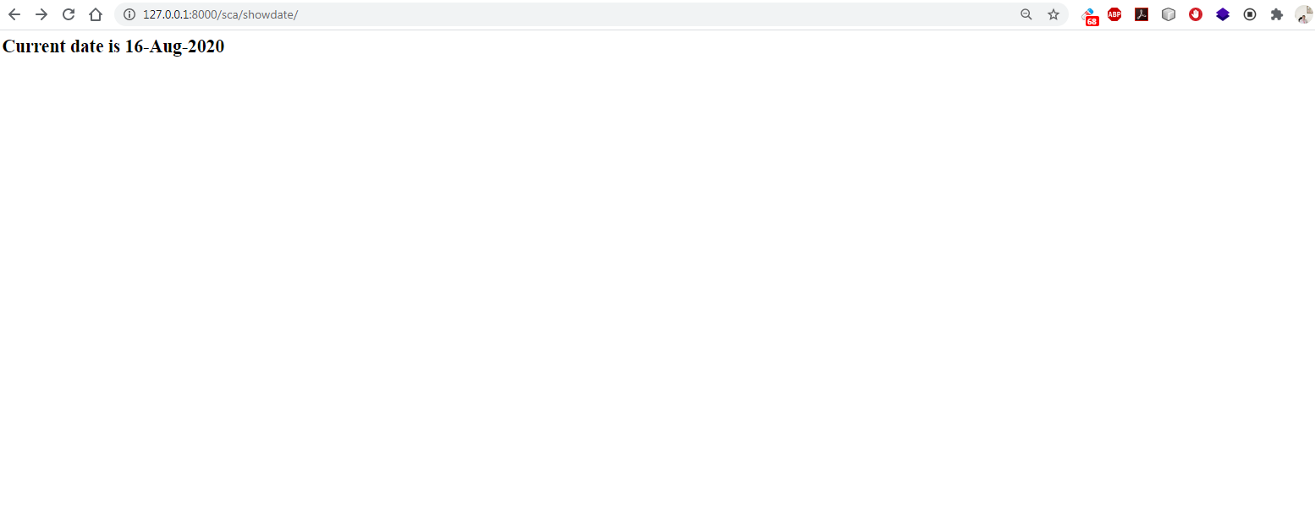
Step 8: Opening The Page
Type the http://127.0.0.1:8000/sca/showdate URL in browser to navigate to
that address. Now we should see current date as the output

Slide 26

Step 8: Opening The Page
Type the http://127.0.0.1:8000/sca/showtime URL in browser to navigate to
that address. Now we should see current time as the output

Slide 27
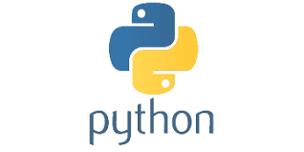
Exercise
Design a project similar to the demoproject3 .
But now your code should have 2 different apps one displays current date and time and the other displays calendar of current month.
Set the appropriate url for date-time page as well as calendar page.
Use app level url mapping for both the apps

